Slide 1


GIT ASSIGNMENT
:GROUP 12

Slide 2
Explained “GIT ADD”
The git add command adds a change in the working directory to the staging area. It tells Git that you want to include updates to a particular file in the next commit. However, git add doesn't really affect the repository in any significant way—changes are not actually recorded until you run git commit .
Syntax :-
Git add [ ]

Slide 3
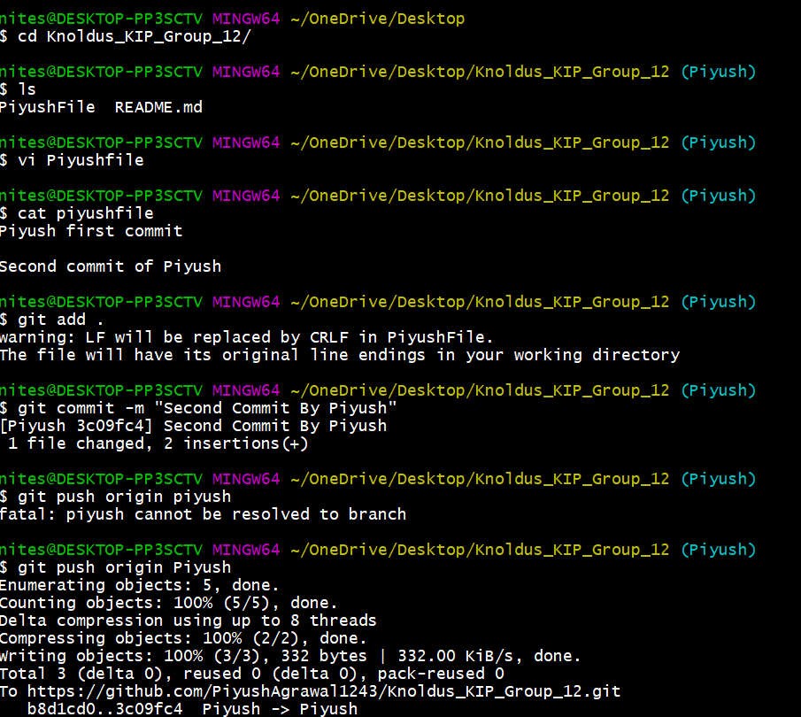
Piyush

Slide 4
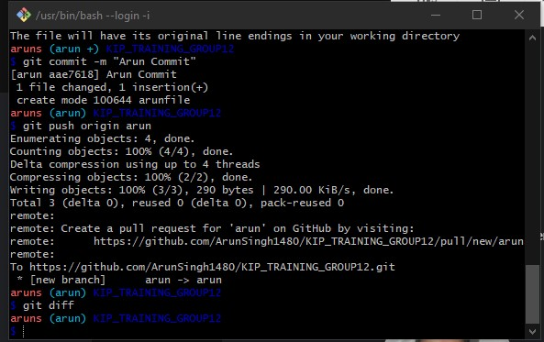
Arun singh

Slide 5
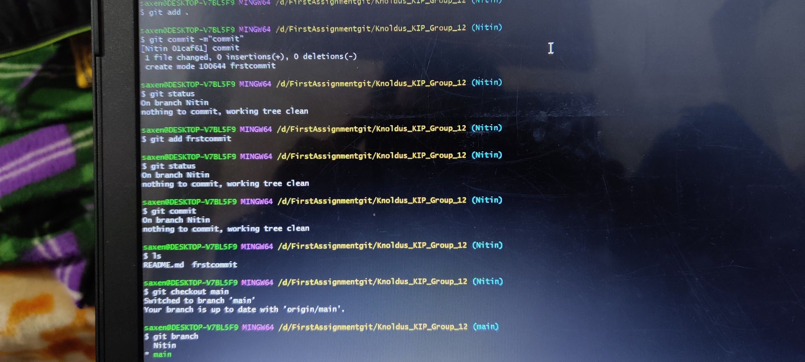
Nitin Saxena

